Slide 1






Less than 4% of Archived Instagram Account Pages for the Disinformation Dozen are Replayable
Haley Bragg¹, Himarsha R. Jayanetti², Michael L. Nelson², and Michele C. Weigle²
¹ Christopher Newport University
Newport News, Virginia, USA
@haleybragg17
² Web Science & Digital Libraries Research Group
Old Dominion University, Norfolk VA, USA
@WebSciDL, @oducs
Presented By:
Himarsha R. Jayanetti
@HimarshaJ
JCDL ‘23, ACM/IEEE Joint Conference on Digital Libraries, Hosted by Los Alamos National Laboratory, Santa Fe, NM, June 26 - 30, 2023
Funded by NSF, REU Site: Research Experiences for Undergraduates in Disinformation Detection and Analytics, https://reu.cs.odu.edu/

Slide 2
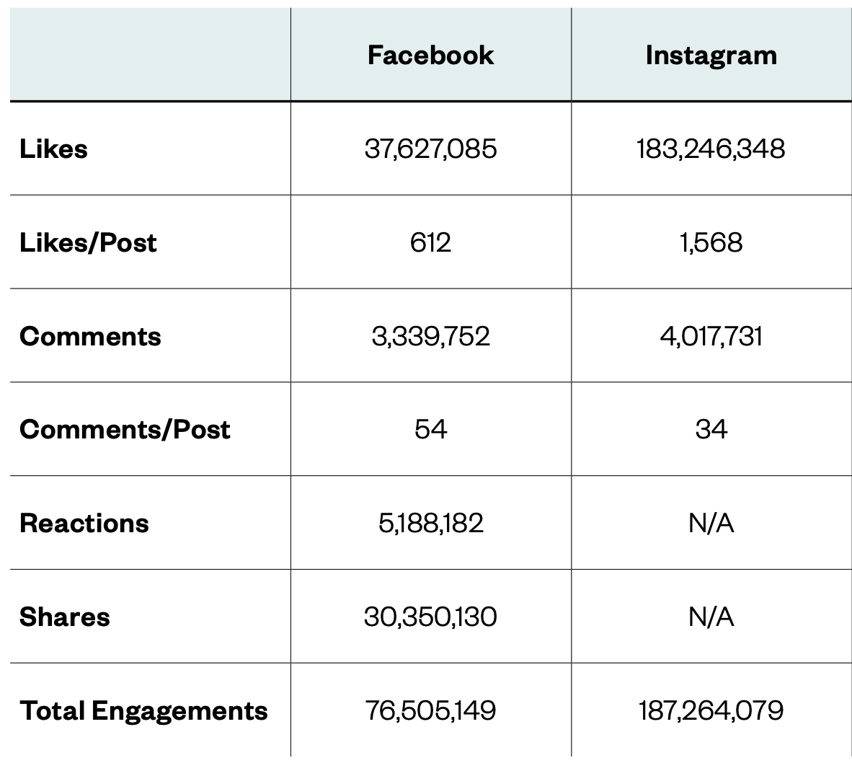
Instagram Was a Significant Front in the IRA’s Influence Operation
Russian Internet Research Agency (IRA)
Manipulated social media narratives to influence American culture and politics in run-up to 2016 US Presidential election
Employed 1000+ people to engage in influence operations, budget of over $25M
Analysis commissioned by the US Senate Select Committee on Intelligence
New Knowledge, "The Tactics & Tropes of the Internet Research Agency", 2018, https://cdn2.hubspot.net/hubfs/4326998/ira-report-rebrand_FinalJ14.pdf

Slide 3
Instagram is 4x Bigger, But 11x Less Studied!
Social Media | Monthly Active Users (AU) | Google Scholar Hits (GSH) | AU/GSH Ratio
Facebook | 3 billion | 7.22 million | 405:1
Instagram | 2 billion | 3.25 million | 615:1
Twitter | 0.45 billion | 8.01 million | 56:1
4x
11x
Based on statistics as of January 22, 2023

Slide 4
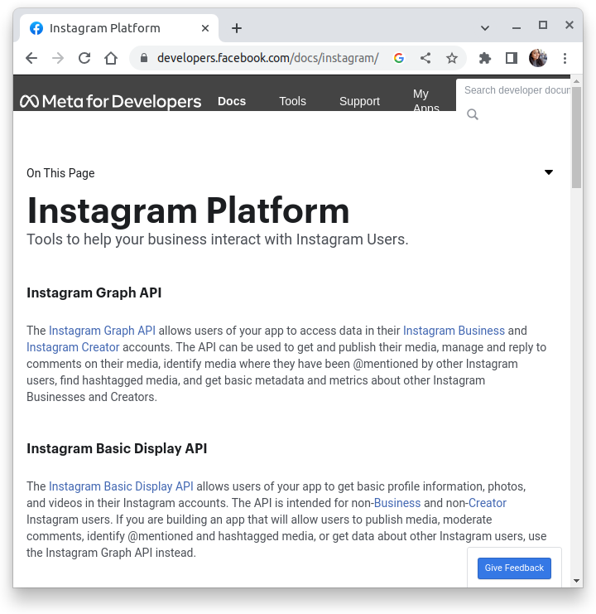
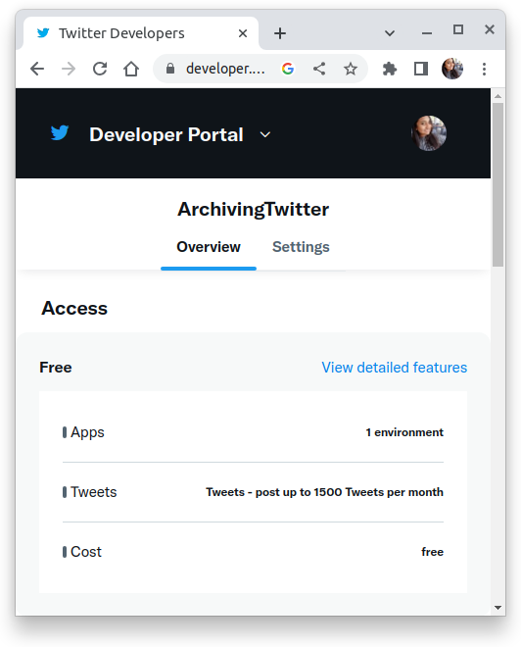
What Makes Instagram an Understudied Platform?
https://developers.facebook.com/docs/instagram/
https://developer.twitter.com/en/portal/dashboard

Slide 5
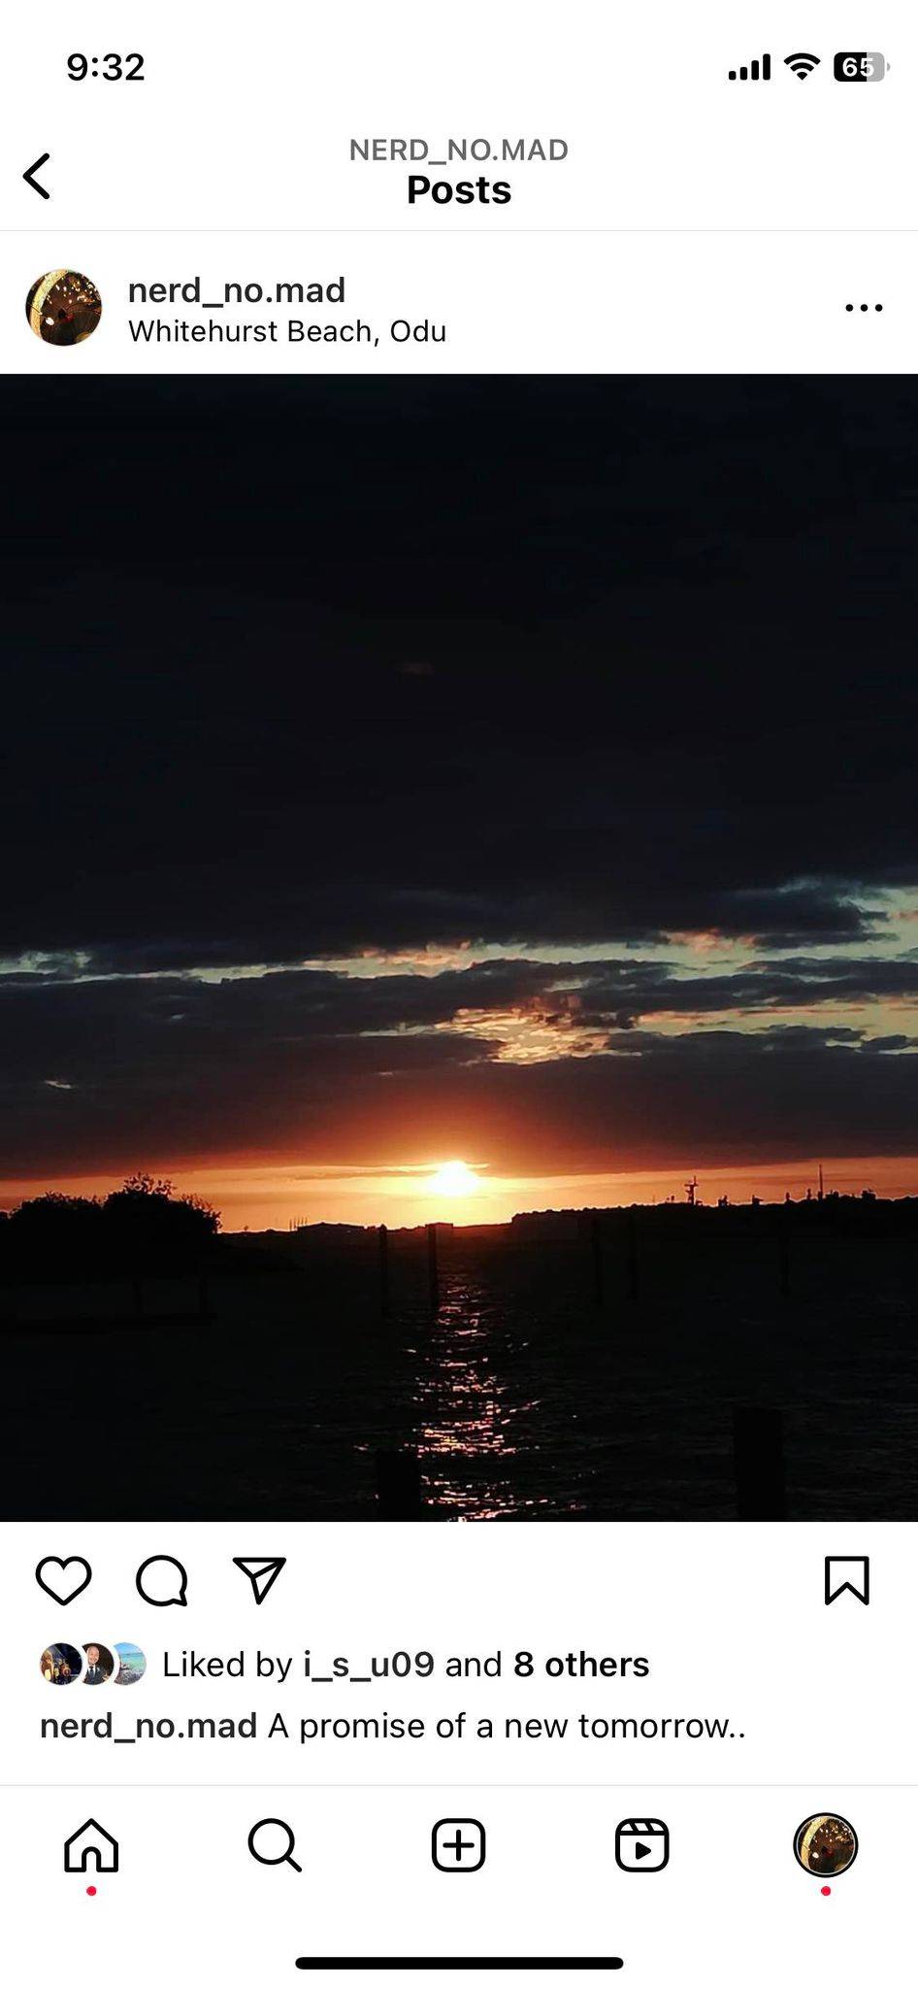
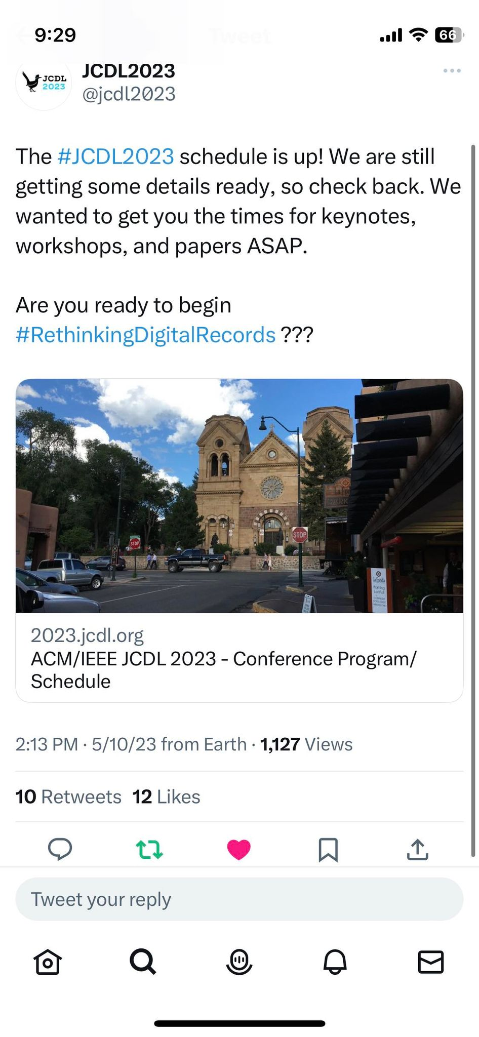
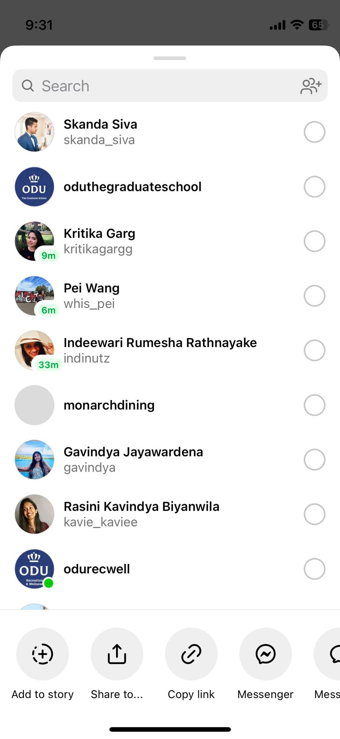
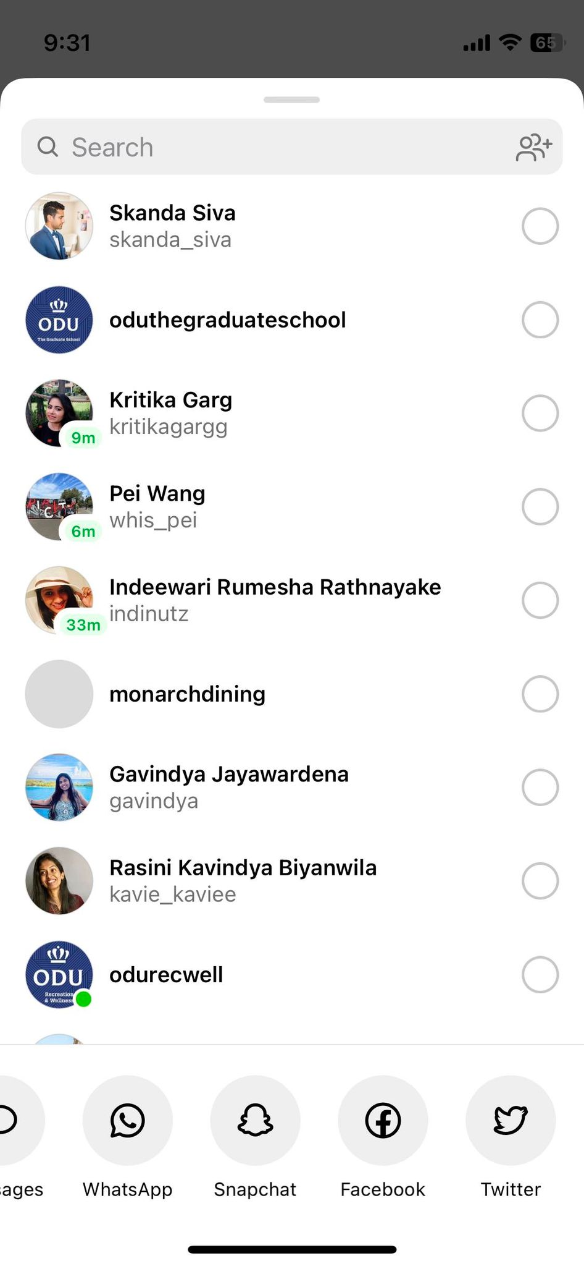
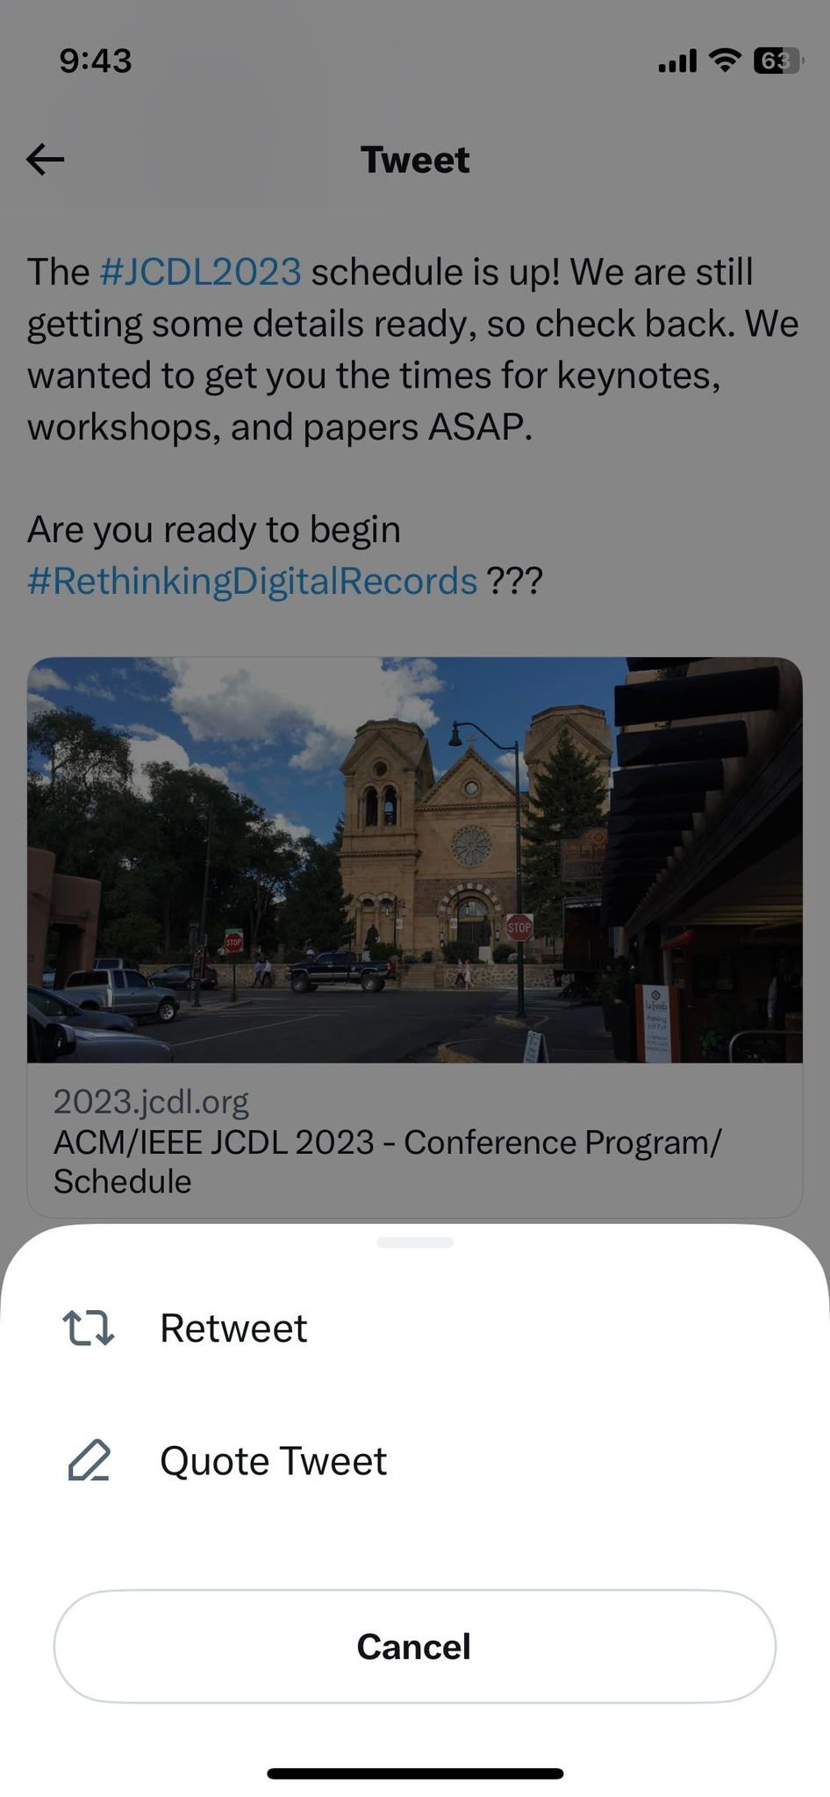
What Makes Instagram an Understudied Platform?
https://developers.facebook.com/docs/instagram/
https://developer.twitter.com/en/portal/dashboard

Slide 6
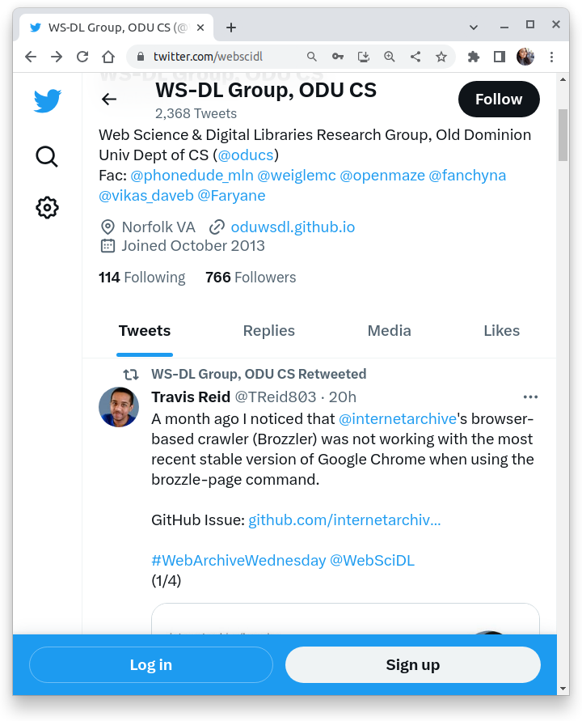
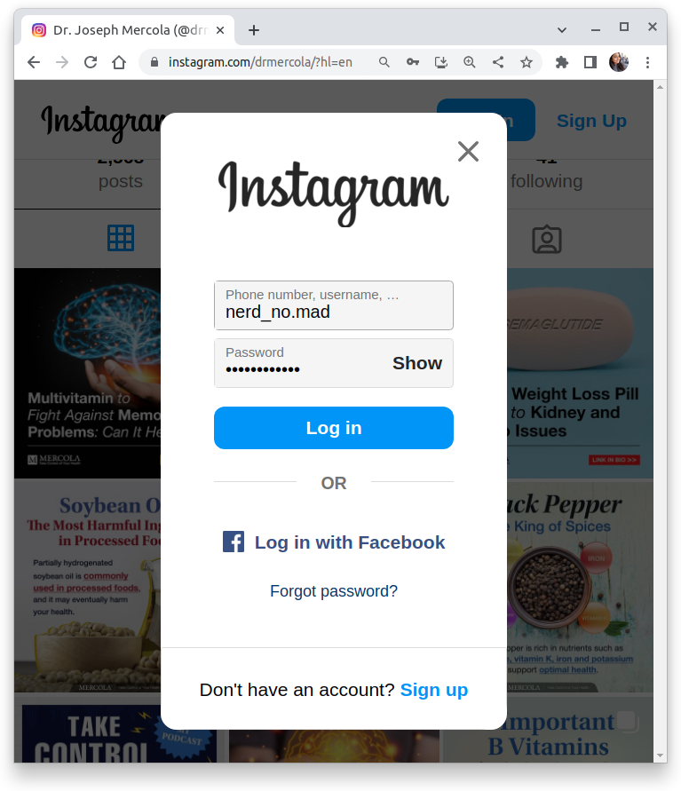
What Makes Instagram an Understudied Platform?
https://developers.facebook.com/docs/instagram/
https://twitter.com/webscidl
https://www.instagram.com/drmercola
https://developer.twitter.com/en/portal/dashboard

Slide 7
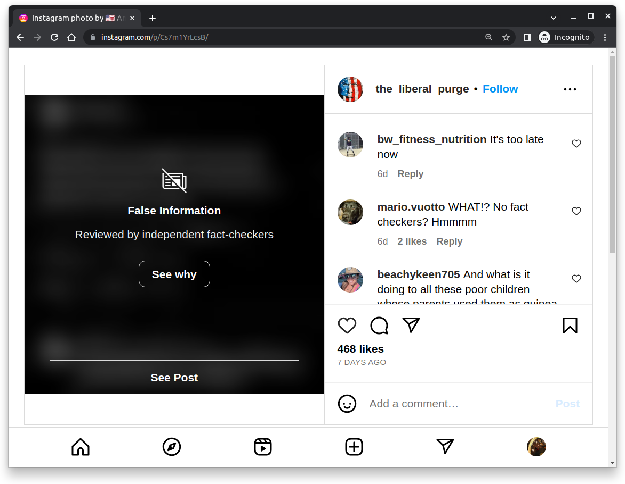
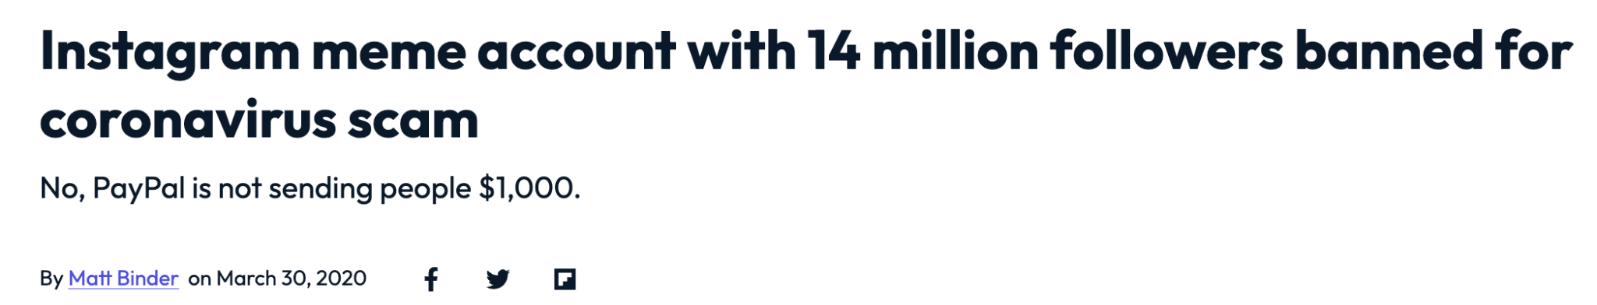
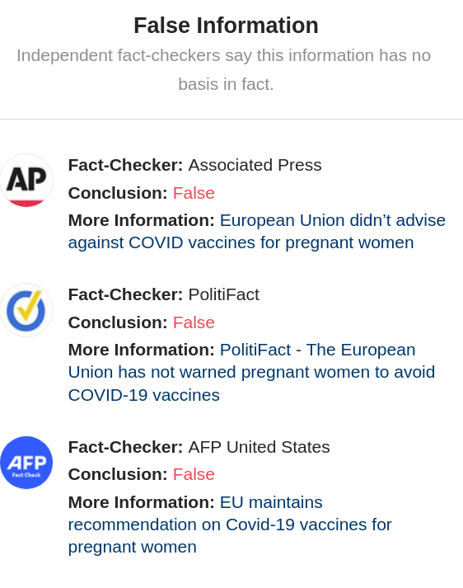
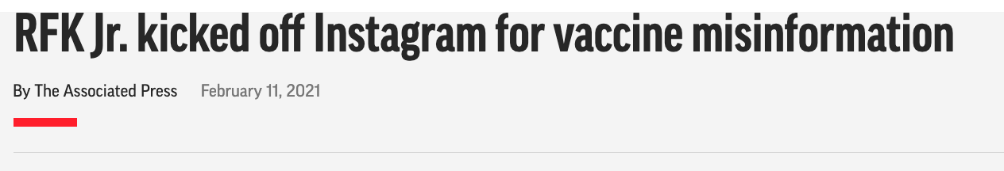
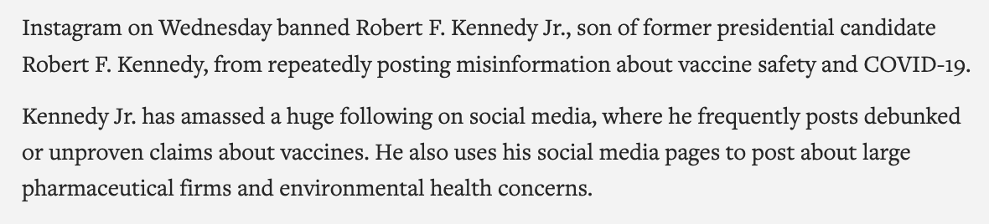
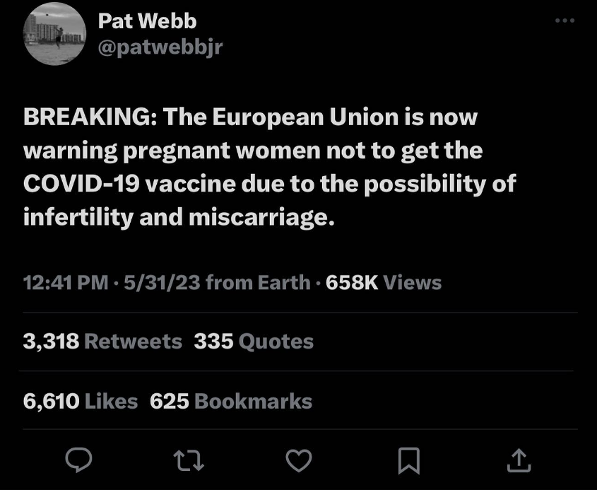
Instagram Banned Posts and Accounts Tied to Spreading Misinformation
https://mashable.com/article/instagram-bestmemes-coronavirus-scam
https://apnews.com/article/rjf-jr-banned-instagram-vaccine-misinfo-d72913572f04ec9b23cec58881bc32d9
Note: @RobertFKennedyJr Instagram account is active again as of June 4, 2023 as he is now an active candidate for President of the United States. But all of his older posts are deleted.
https://www.instagram.com/p/Cs7m1YrLcsB/

Slide 8
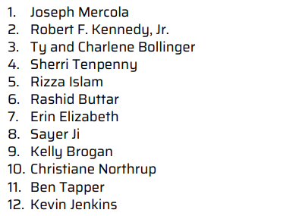

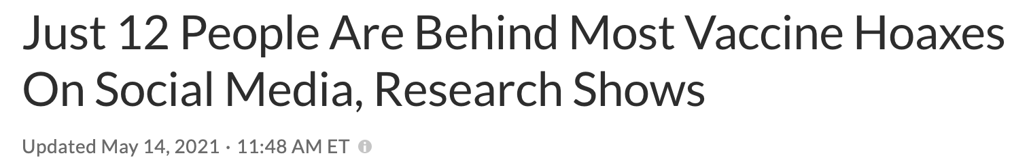

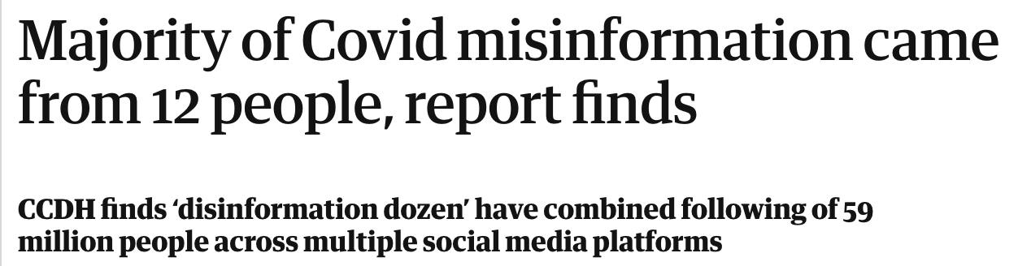
Instagram Has Banned 10 of the “Disinformation Dozen”
*
https://www.npr.org/2021/05/13/996570855/disinformation-dozen-test-facebooks-twitters-ability-to-curb-vaccine-hoaxes
https://www.theguardian.com/world/2021/jul/17/covid-misinformation-conspiracy-theories-ccdh-report
“The Disinformation Dozen: Why Platforms Must Act on Twelve Leading Online Anti-Vaxxers”, Center for Countering Digital Hate, 2021, https://counterhate.com/research/the-disinformation-dozen/

Slide 9
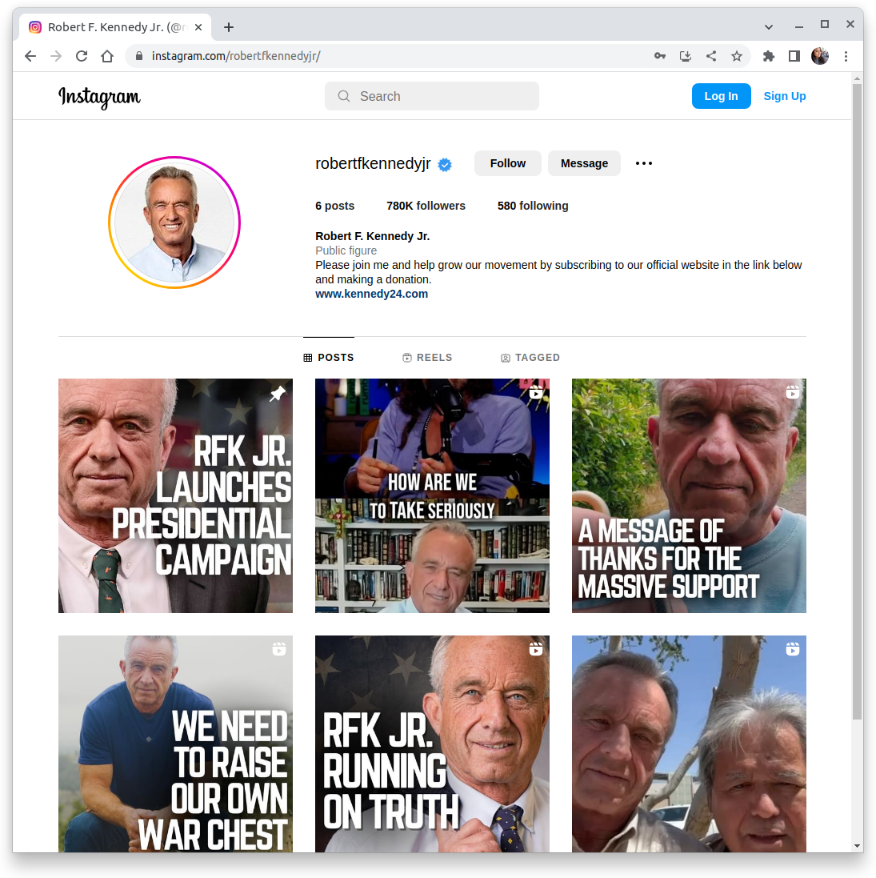
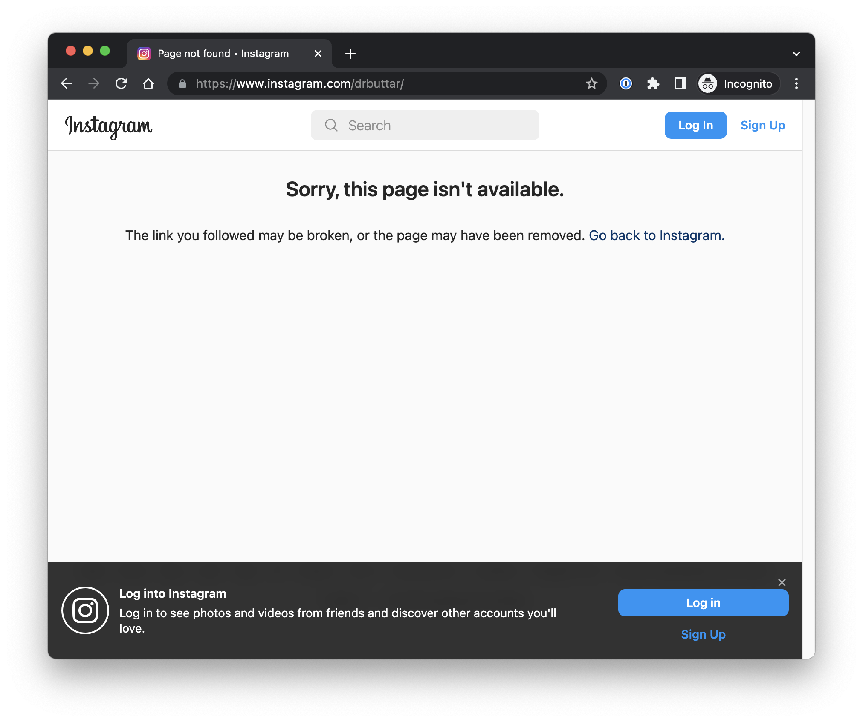
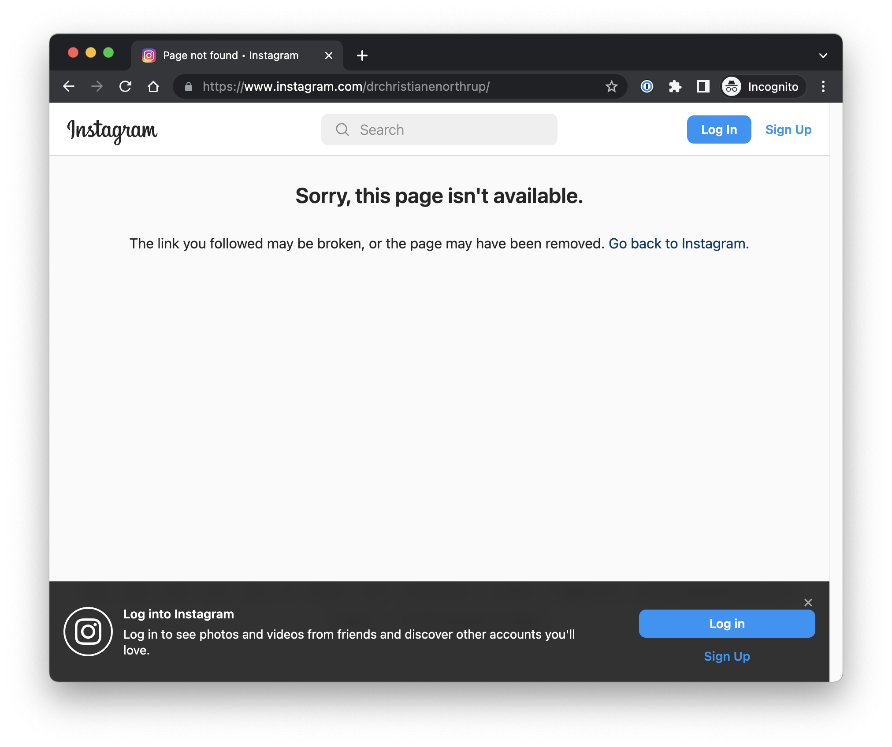
You Can’t View Banned Accounts on the Live Web
*
instagram.com/drbuttar/
instagram.com/drchristianenorthrup/
instagram.com/robertfkennedyjr/
Screenshot captured on 2023-06-15

Slide 10
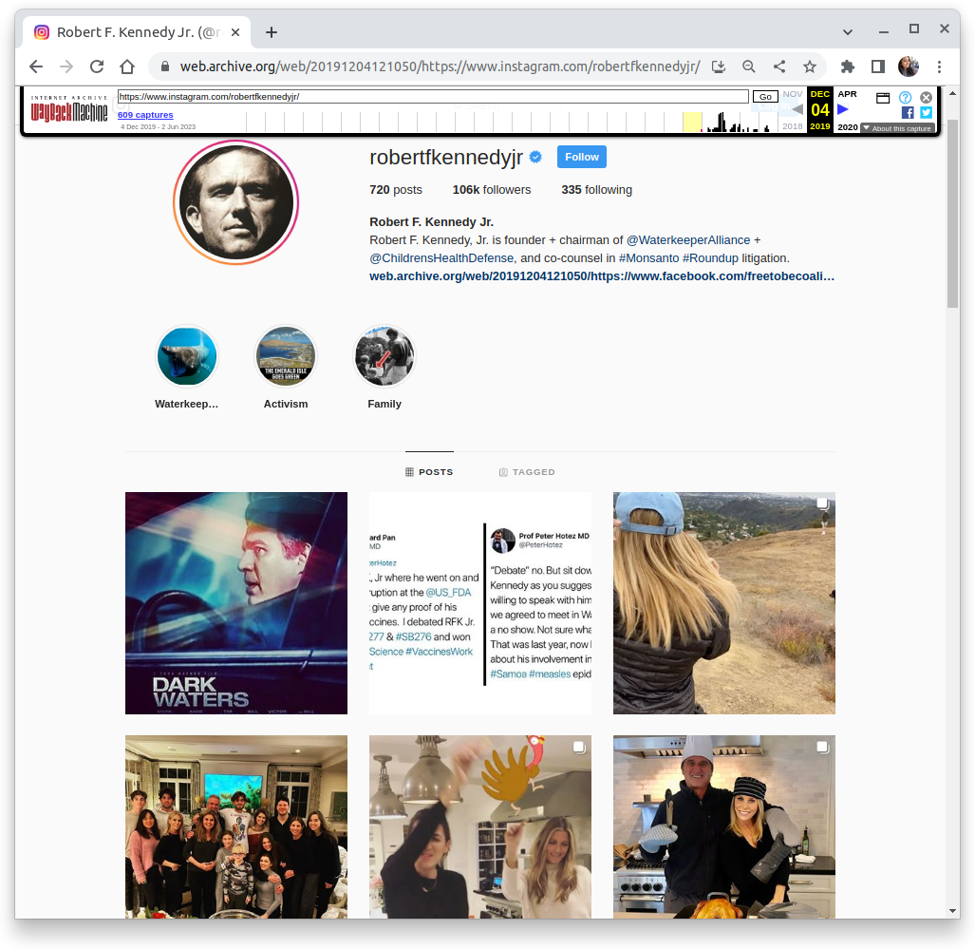
Web Archives Can Provide Access to Past Versions of Webpages
If the Instagram account pages were archived before they were banned, we can study the content to learn about their tactics.
Largest public web archive is the Internet Archive's (IA) Wayback Machine, https://web.archive.org/
Memento Datetime
Archived on December 04, 2019
https://web.archive.org/web/20191204121050/https://
www.instagram.com/robertfkennedyjr/
Archived copy (memento, or URI-M) of an account page (original resource, or URI-R) archived on December 04, 2019 (Memento Datetime).

Slide 11
Research Questions
RQ1: How many mementos are available for these account pages and how many of them are replayable?
RQ2: Does replayability guarantee a complete capture that is fully representative of the content user posts?

Slide 12
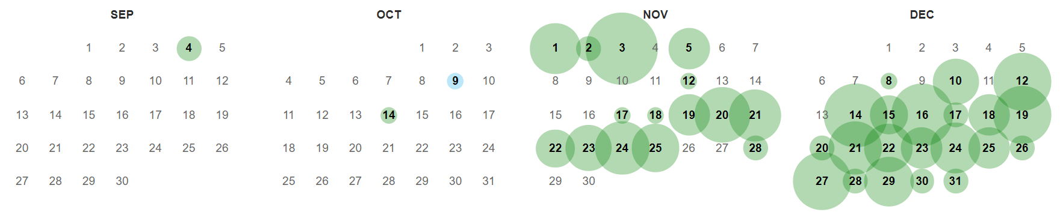
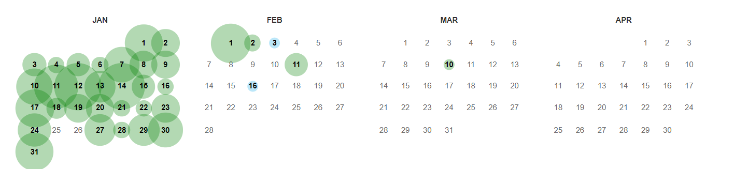
598 Mementos for @RobertFKennedyJr in IA
2020
2021
Banned
Measured as of Summer 2022
https://web.archive.org/web/20200000000000*/https://www.instagram.com/robertfkennedyjr/
https://web.archive.org/web/20210000000000*/https://www.instagram.com/robertfkennedyjr/

Slide 13
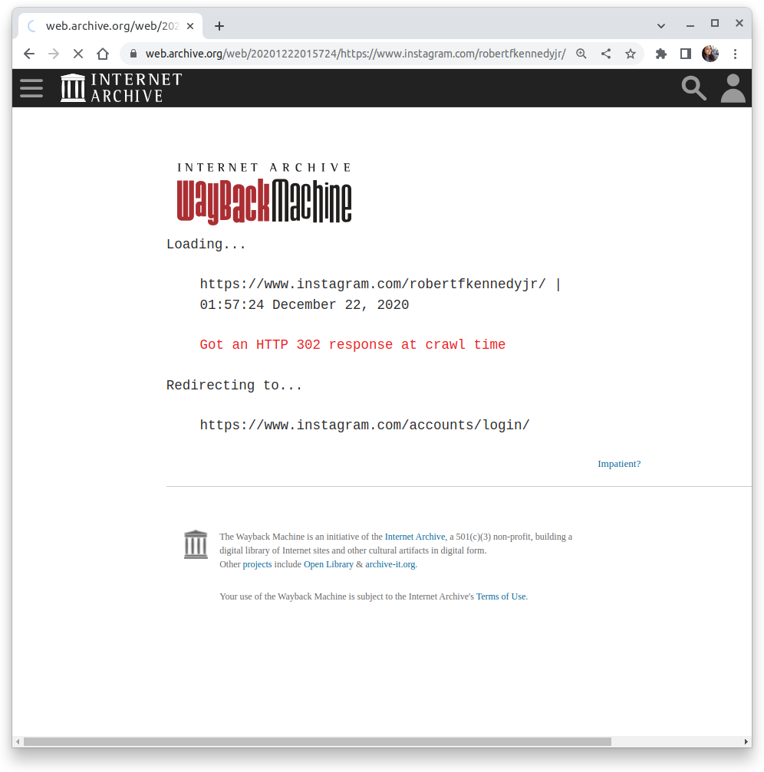
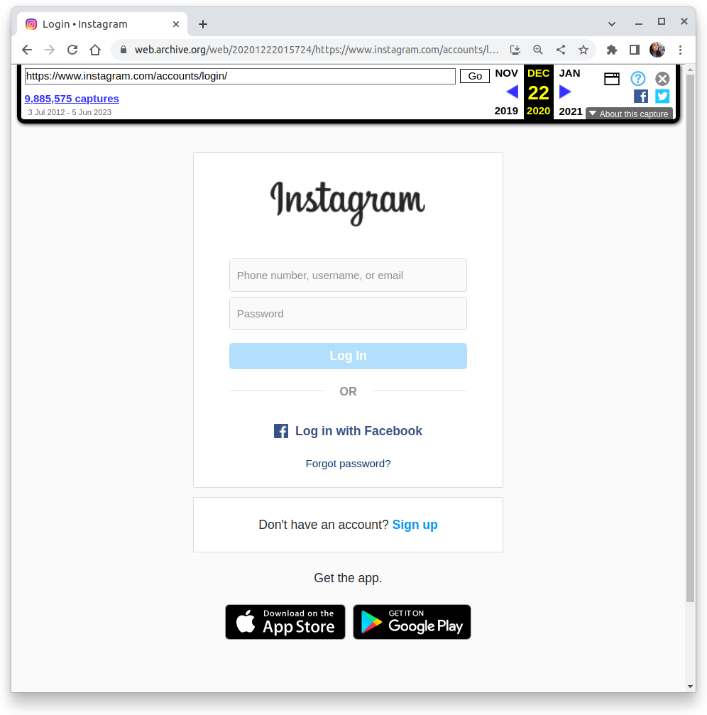
But Most of These Just Redirect to the Instagram Login Page
https://web.archive.org/web/20201222015724/
https://www.instagram.com/robertfkennedyjr/
https://web.archive.org/web/20201222015724/
https://www.instagram.com/accounts/login/

Slide 14
Only 6 Successful Replays for @RobertFKennedyJr
 | Mementos | Percentage
Redirects to Login Page | 592 | 99.0%
Replayed Account Pages | 6 | 1.0%
Total Mementos | 598 | 100%

Slide 15
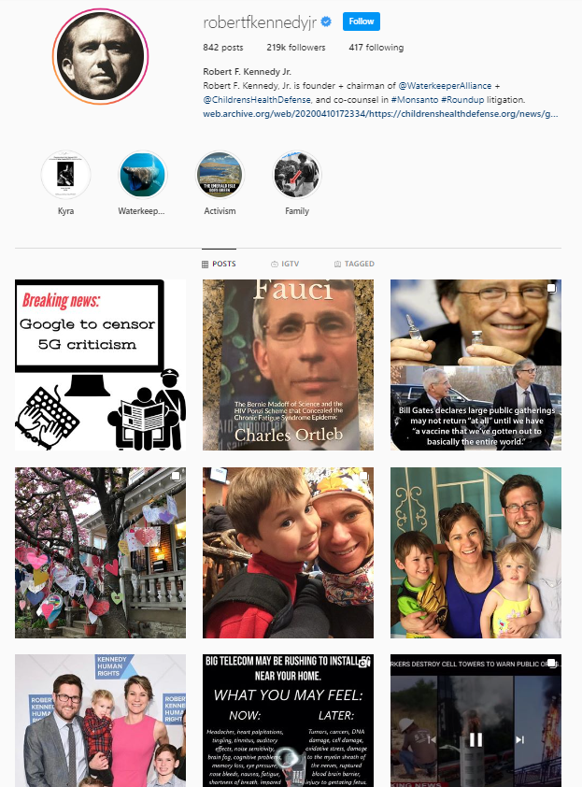
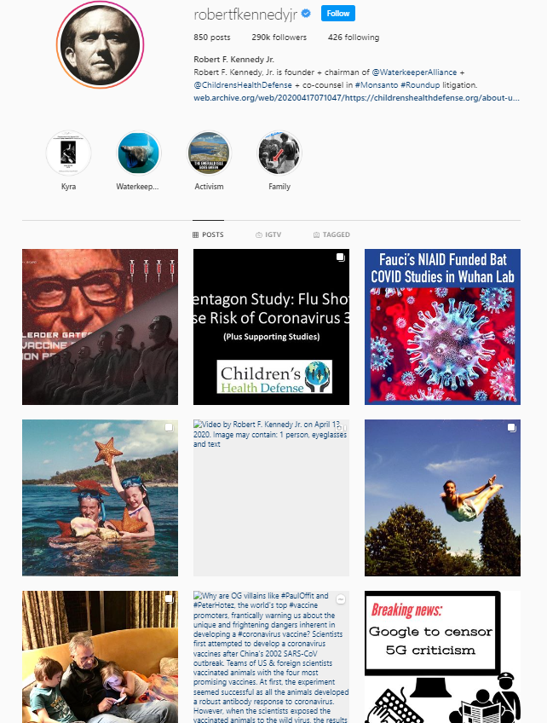
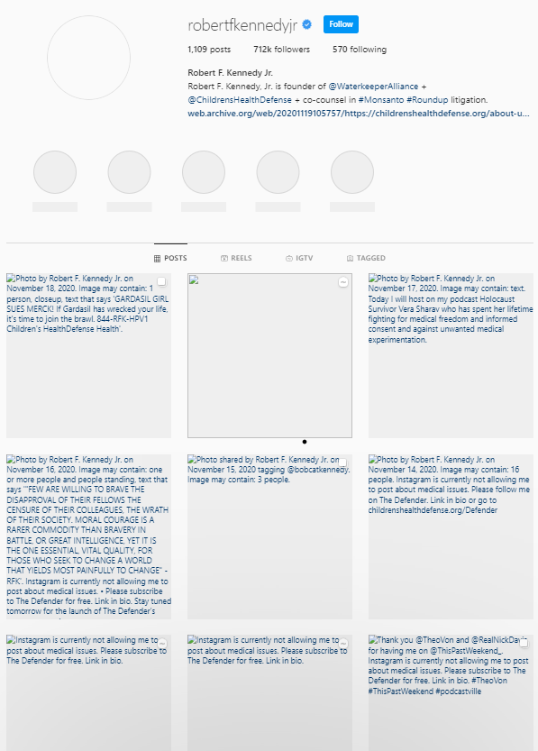
Of Those 6, Only 2 Mementos Are “Complete”
2/6 have complete loaded post images
1/6 has partial loaded post images
3/6 have zero loaded post images
3/6 have zero loaded post images
2020-04-10
2020-04-17
2020-11-19

Slide 16
Research Questions
RQ1: How many mementos are available for these account pages and how many of them are replayable?
RQ2: Does replayability guarantee a complete capture that is fully representative of the content user posts?

Slide 17
Less than 4% of Archived Instagram Account Pages are Replayable
 | Mementos | Percentage
Redirects to Login Page | 2,012 | 96.08%
Replayed Account Pages | 80 | 3.82%
Total | 2,094 | 100.00%

Slide 18
Research Questions
RQ1: How many mementos are available for these account pages and how many of them are replayable?
RQ2: Does replayability guarantee a complete capture that is fully representative of the content user posts?

Slide 19
We Used the Number of Post Images That Are Present in the Memento as a Completeness Measure
2/6 have complete loaded post images
1/6 has partial loaded post images
3/6 have zero loaded post images
2020-04-10
2020-04-17
2020-11-19

Slide 20
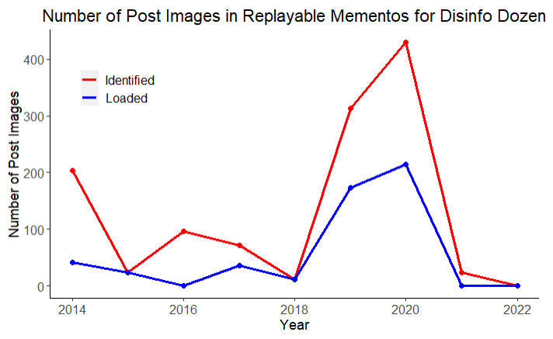
Quality of Replayable Mementos Over Time
Identified: Number of post images requested across all mementos for that year.
Loaded: Number of post images that actually displayed correctly.

Slide 21
Quality of Replayable Mementos Over Time
Identified: Number of post images requested across all mementos for that year.
Loaded: Number of post images that actually displayed correctly.

Slide 22
A Lack of Both Identified & Loaded Post Images for the Years 2015, 2018, 2021, & 2022
Identified: Number of post images requested across all mementos for that year.
Loaded: Number of post images that actually displayed correctly.

Slide 23
Over Half of the 300 Identified Post Images Displayed Correctly in 2019
In 2019, 55% of Identified Post Images Loaded
Identified: Number of post images requested across all mementos for that year.
Loaded: Number of post images that actually displayed correctly.
What happened in 2019?
We're not sure (yet).

Slide 24
Only 1% of Mementos for the Disinformation Dozen Accounts Are Replayable With Complete Post Images
Quality | % (out of replayable) | % (out of all)
No loaded post images | 64% | 2.45%
Partial loaded post images | 9% | 0.34%
Complete loaded post images | 27% | 1.03%
Notes:
Calculation - Sheet 2 https://docs.google.com/spreadsheets/d/17ScR8bWM8_RIMVxQZFARYj6MemTaoXf0qMCHp_VjnXU/edit#gid=36978439

Slide 25
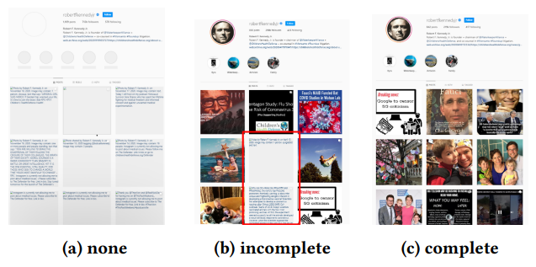
Key Takeaways
Web archives are an essential resource for studying content that was posted in banned accounts.
Instagram itself is not well-archived, and 96% of mementos of Disinformation Dozen account pages redirect to the login page.
Only 27.16% of replayable mementos for the Disinformation Dozen replay every post image.
Overall, only 1.05% of mementos for the Disinformation Dozen accounts are replayable with complete post images.
Future Work: Compare results with other banned accounts, study how to improve archiving of popular Instagram accounts.
https://github.com/oduwsdl/DisinformationDozen

Slide 26
Backup Slides

Slide 27
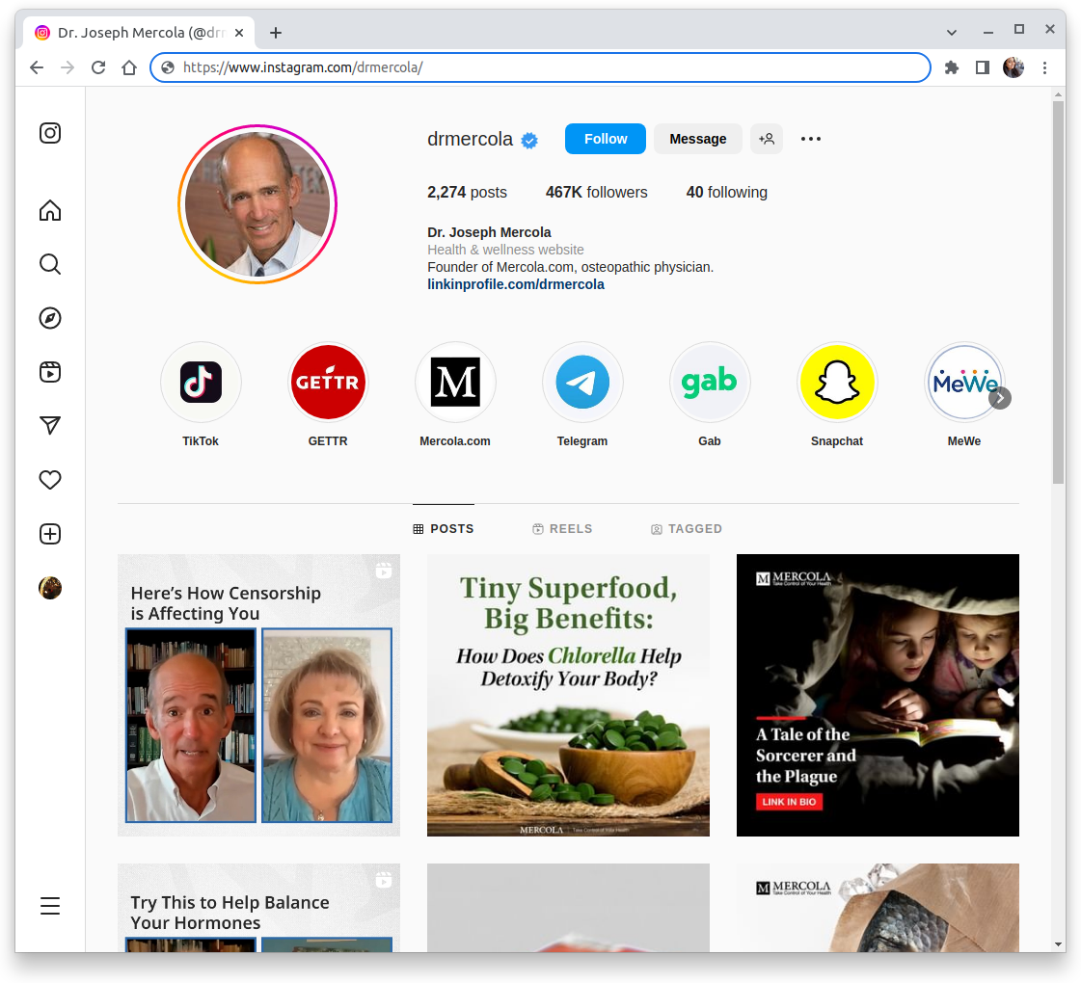
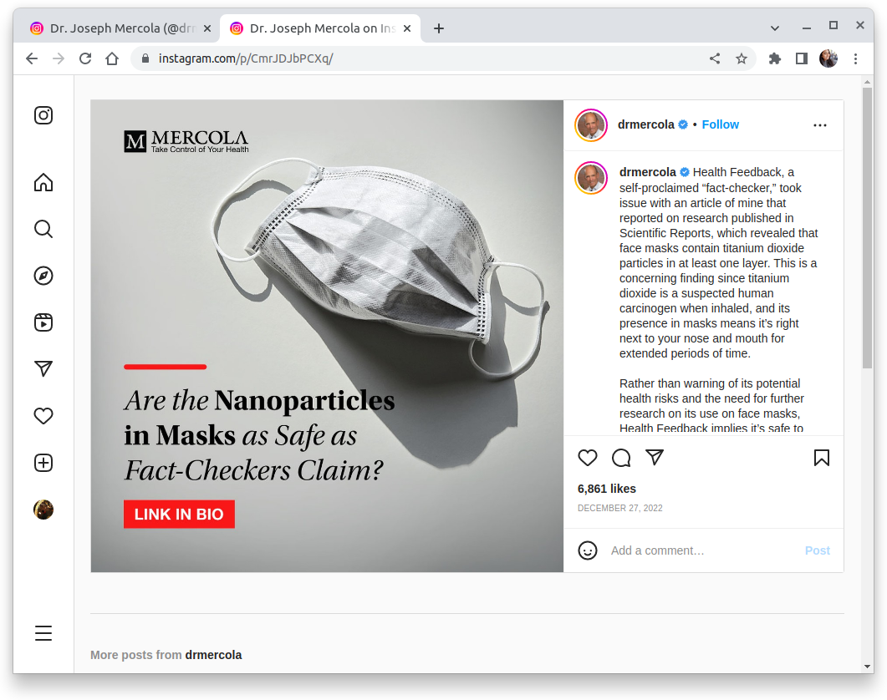
Instagram Account Page vs. Post Page
https://www.instagram.com/drmercola/
https://www.instagram.com/p/CmrJDJbPCXq/

Slide 28
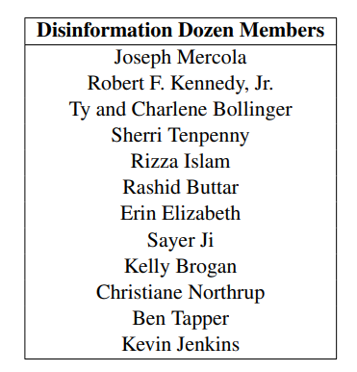
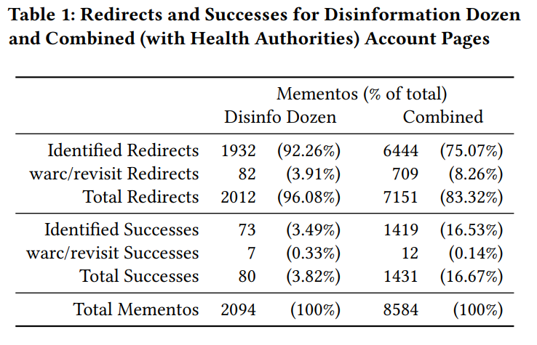
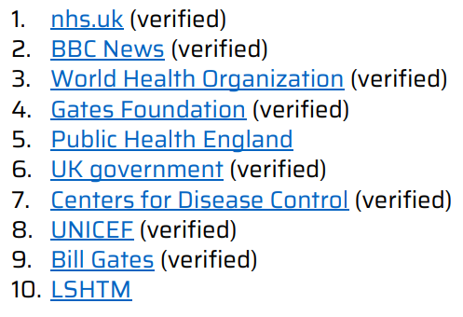
Full Dataset
https://counterhate.com/research/the-disinformation-dozen/
https://counterhate.com/research/malgorithm-fix-instagram/

Slide 29
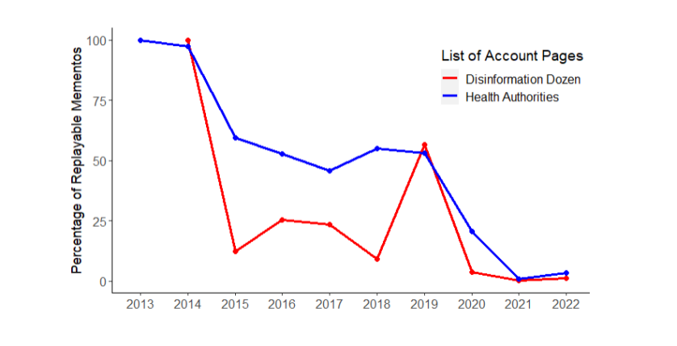
Percentage of Replayable Mementos Over Time

Slide 30
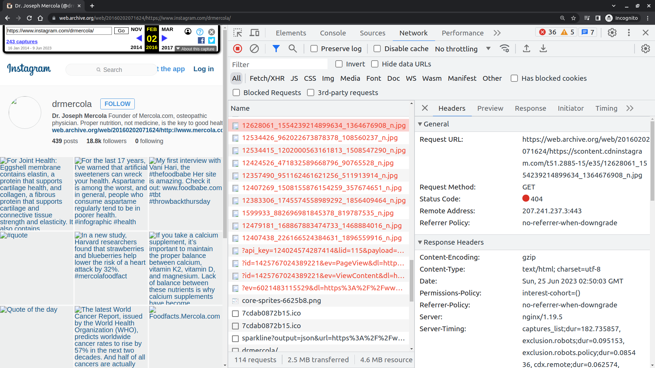
Selenium Wire to Identify if the Post Are Loaded
https://web.archive.org/web/20160202071624/https://www.instagram.com/drmercola/

